Slide 1

Director Briefing Document

Slide 2
Contents
1 | Company Overview
2 | Board Bios
3 | Executive Bios
4 | Board Calendar
5 | Director Compensation

Slide 3
Company Overview

Slide 4
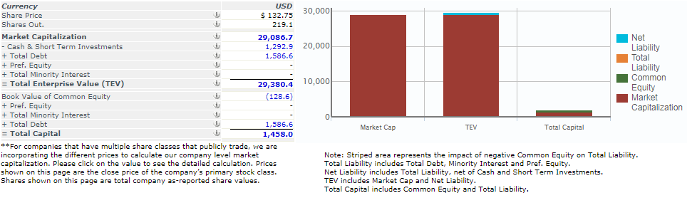

Company Overview
Autodesk: Autodesk is a leader in 3D design, engineering and entertainment software. It operates as a design software and services company worldwide. With more than a million seats of professional products, 170 million users of consumer applications, 9,500 employees worldwide and products available in up to 17 languages, Autodesk provides free access to its software to students, teachers and academic institutions worldwide. The Company serves customers in the architecture, engineering, and construction; manufacturing; and digital media, consumer, and entertainment industries. The Company’s sophisticated software products enable its customers to experience their ideas before they are real by allowing them to imagine, design, and create their ideas and to visualize, simulate, and analyze real-world performance early in the design process by creating digital prototypes. These capabilities allow Autodesk’s customers to foster innovation, optimize and improve their designs, help save time and money, improve quality, and collaborate with others.
Capitalization (2018)
*Source: Autodesk website (Corporate info) and website

Slide 5
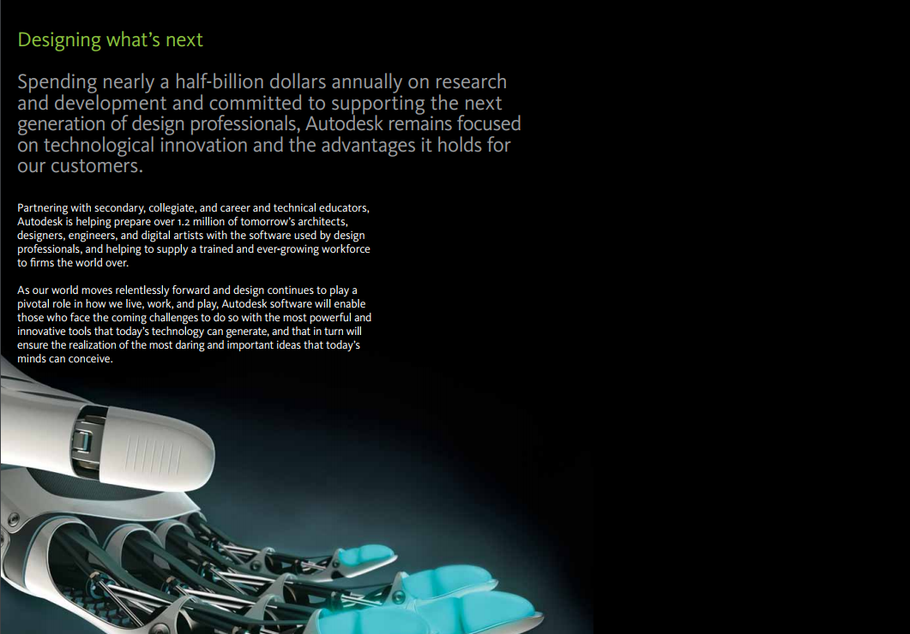
Company Overview (continued)
Source: Corporate Brochure (2018)

Slide 6
Company Overview (continued)
Financial Performance (2018)
Source: Company Annual report (2018)

Slide 7
Company Overview (continued)
Segment Performance (2018)
Source: Company Annual report (2018)

Slide 8
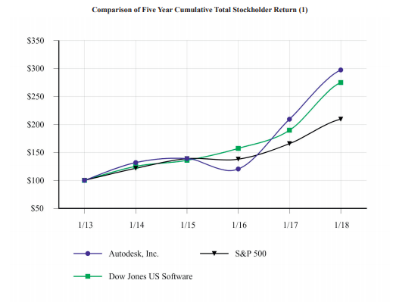
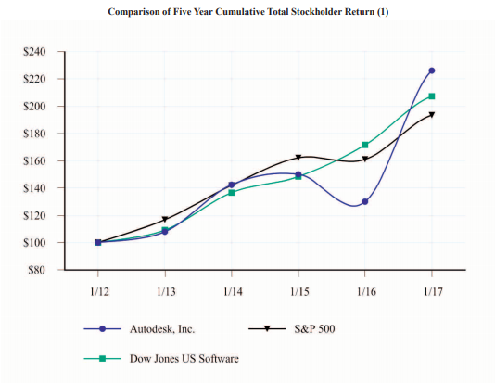
Company Overview (continued)
Company Stock Performance (2018 vs 2017)
Source: Company Annual report (2018)

Slide 9
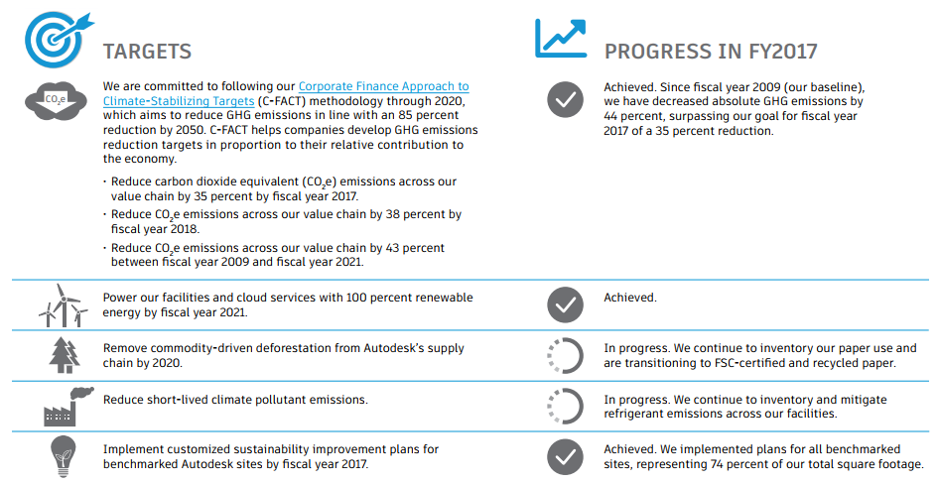

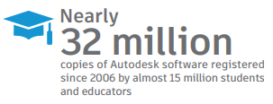

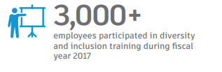

Company Overview (continued)
Autodesk Foundation
Source: Company Website

Slide 10
Board Bios

Slide 11
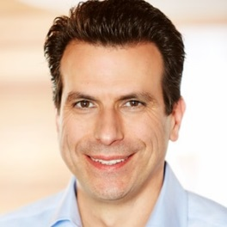
Board Bios
Andrew Anagnost
President and CEO
Board Director
Andrew Anagnost is the President and Chief Executive Officer of Autodesk.
Anagnost’s career spans more than 25 years of product, business, and marketing experience focused on driving strategy, transformation, and product development — and includes positions at Autodesk, Lockheed Aeronautical Systems Company, and EXA Corporation. He also completed a doctorate degree at Stanford University and worked at NASA Ames Research Center as an NRC post-doctoral fellow.
Anagnost began his career at Autodesk in 1997 and has held a wide range of roles in the areas of marketing, new business development, product management, and product development. Prior to becoming President and CEO in June 2017, he served as Chief Marketing Officer and SVP of the Business Strategy & Marketing organization. In this role, Andrew served as architect and leader of Autodesk’s business model transition—moving the company to become a software-as-a-service (SaaS) solutions provider. Previously, Anagnost held various executive positions across Autodesk. Early in his Autodesk career, he led the development of the company’s manufacturing products and grew Autodesk Inventor revenue to over $500 million.
Anagnost is a member of the Autodesk Board of Directors. He holds a Bachelor of Science Degree in Mechanical Engineering from the California State University, and holds both an MS in Engineering Science and a PhD in Aeronautical Engineering and Computer Science from Stanford University.

Slide 12
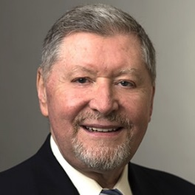
Board Bios (continued)
Crawford W. Beveridge, CBE
Non-executive Chairman of the Board
Crawford W. Beveridge is a technology industry veteran with more than 35 years of experience. Before his departure in January 2010, Beveridge served as an executive at Sun Microsystems for over 15 years. Most recently, Beveridge represented Sun’s interests in geographies outside of the U.S., particularly in high growth geographies such as the EU, Brazil, Russia, India and China. In 1991, Beveridge left Sun to become the chief executive of Scottish Enterprise, the lead economic development organization for Scotland.
In this role he oversaw business development, venture capital, skills development, exports, infrastructure and inward investment. Beveridge returned to Sun in April 2000 as executive vice president of People and Places and Chief Human Resources Officer.
Before joining Sun in 1985 as vice president corporate resources, he held HR management positions in the United States and Europe with Hewlett-Packard, Digital Equipment Corporation and Analog Devices Inc. In addition to being non-executive Chairman of the Board of Autodesk, Beveridge is Chairman of Scottish Equity Partners Ltd and a non-executive board member of iomart Group plc.
Beveridge holds a B.Sc. in Social Sciences from the University of Edinburgh, Scotland and an M.Sc. in Industrial Administration from the University of Bradford, England. He also holds honorary Doctoral degrees from the University of Edinburgh, Napier University in Edinburgh and Robert Gordons University, Aberdeen. He was awarded a C.B.E. (Commander of the Order of the British Empire) in the Queen's New Years Honours list in 1995.

Slide 13
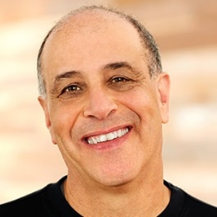
Board Bios (continued)
Carl Bass
Carl Bass is a member of the Autodesk board of directors and is presently serving as an advisor to the company. During his 24 year tenure at Autodesk, he has held a series of executive positions including president and chief executive officer, chief technology officer and chief operations officer. Bass co-founded Ithaca Software, which was acquired by Autodesk in 1993. Bass also serves on the boards of directors of HP Inc., Zendesk Inc. and Planet; on the board of trustees of the Smithsonian's Cooper-Hewitt National Design Museum, Art Center College of Design, and California College of the Arts; and on the advisory boards of Cornell Computing and Information Science, UC Berkeley School of Information, and UC Berkeley College of Engineering.
He holds a bachelor’s degree in mathematics from Cornell University. Bass spends his spare time building things—from chairs and tables to boats, and most recently, an electric go-kart.

Slide 14
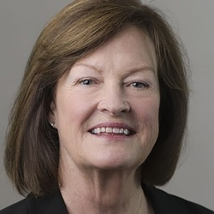
Board Bios (continued)
Karen Blasing
Karen Blasing has more than 25 years of financial leadership experience and was most recently the CFO of Guideware Software. While at Guideware Software, she led the financial operations of the company and established a technology platform that enhances insurers’ ability to engage and empower their customers and employees. Blasing was also instrumental in helping transform the business model from a perpetual license business to a profitable recurring revenue model during her time at Guideware Software.
Prior to joining Guideware Software in 2009, Blasing served as chief financial officer of Force10 Networks and was senior vice president of finance at Salesforce.com.
Blasing holds a bachelor’s degree in economics from University of Montana and a master’s in Business Administration from the University of Washington. She sits on the board of directors for Ellie Mae and Zscaler. She also serves as a member of Autodesk’s Audit Committee.

Slide 15
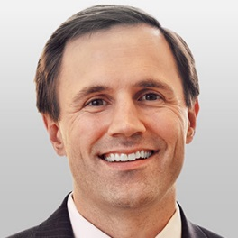
Board Bios (continued)
Reid French
Reid French is chief executive officer at Applied Systems, the leading cloud software provider to the insurance distribution industry. He is responsible for the company’s overall business strategy, operational execution and plays a role developing and fostering relationships throughout the Applied community.
Prior to joining Applied in 2011, French served as chief operating officer at Intergraph Corporation, a global geospatial and computer-aided design software company. Early in his career, he was a strategic planner for Walt Disney Company, and managed investment banking transactions in the technology sector for Robinson-Humphrey.
French holds a bachelor’s degree in economics from Davidson College, where he serves on the college’s board of visitors. He also holds a master’s in Business Administration from the Harvard Business School. He sits on the board of directors for Applied Systems and The Lovett School in Atlanta.

Slide 16
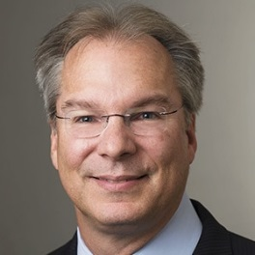
Board Bios (continued)
Thomas Georgens
Tom Georgens served as chief executive officer and president of NetApp and a member of its board of directors. In other roles at NetApp, he previously served as executive vice president and general manager of enterprise storage systems, executive vice president of product operations and chief operating officer. Before joining NetApp, Georgens served LSI Corporation and its subsidiaries, in various capacities, including as chief executive officer of Engenio and executive vice president of LSI Logic.
Prior to NetApp, Georgens spent 11 years at EMC Corporation in a variety of engineering and marketing roles.
Georgens also serves on the board of directors of Electronics for Imaging, Inc.
Georgens received B.S. and M.Eng. degrees in computer and systems engineering from Rensselaer Polytechnic Institute and an MBA from Babson College.

Slide 17
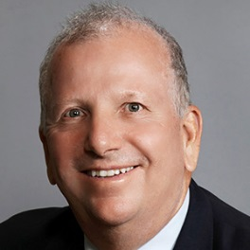
Board Bios (continued)
Richard S. Hill
Richard (Rick) S. Hill currently serves as Chairman of the Board of Directors of Tessera Technologies, Inc. and as a member of the boards of directors of Arrow Electronics, Inc., Cabot Microelectronics Corporation, Marvell Technology Group and Yahoo!.
He served as Tessera’s Interim Chief Executive Officer from April 2013 until May 2013. He previously served as the Chairman and Chief Executive Officer of Novellus Systems Inc., until its acquisition for more than $3 billion by Lam Research Corporation in June 2012. During his nearly 20 years leading Novellus Systems, Rick grew annual revenues from approximately $60 million to over $1.7 billion.
Before joining Novellus in 1993, Rick spent 12 years with Tektronix Corporation and also worked in a variety of engineering and management positions with General Electric, Motorola and Hughes Aircraft Company.
He received a B.S. in Bioengineering from the University of Illinois in Chicago and an M.B.A. from Syracuse University.

Slide 18
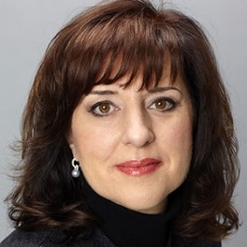
Board Bios (continued)
Mary T. McDowell
Mary McDowell is the chief executive officer and member of the board for Polycom, Inc. Prior to joining Polycom, Mary was in charge of Nokia’s Mobile Phones unit, where she successfully built on Nokia’s No. 1 position in feature phones with a refreshed and compelling new portfolio of devices and services targeted to meet the needs of urban youth in emerging markets.
She also had responsibility for Nokia’s global developer organization. She served as a member of the Nokia Leadership Team from 2004 - 2012 and as a member of the Navteq board, following its acquisition by Nokia in 2008.
Mary joined Nokia in 2004 as executive vice president and general manager of Enterprise Solutions, responsible for the development and marketing of Nokia's range of business-oriented devices and solutions. Mary served as executive vice president and chief development officer, leading the Corporate Development unit, from 2008 until assuming the Mobile Phones unit role.
Before joining Nokia, Mary served 17 years at HP-Compaq, after joining as a systems engineer in 1986. She was senior vice president and general manager of the Industry-Standard Servers Group at Hewlett Packard and Compaq for five years, leading a multi-billion dollar business and the world's largest server franchise.
Mary is a member of the board of directors of UBM plc and Bazaarvoice, a leading provider of social commerce solutions.
She holds a bachelor's degree in computer science from the University of Illinois College of Engineering, who recently granted her the Distinguished Alumni award. She serves on the College's Board of Visitors.

Slide 19
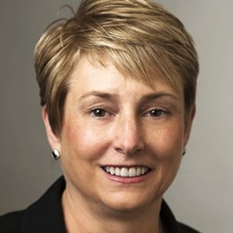
Board Bios (continued)
Lorrie M. Norrington
Lorrie Norrington has over 30 years of operating experience in technology, software, and internet businesses. Norrington currently serves as an Advisor and in an Operating Partner capacity for Lead Edge Capital. Lead Edge is a growth equity firm that partners with world-class entrepreneurs and exceptional technology businesses.
Prior to Lead Edge Capital, Norrington was the President of eBay Marketplaces and led all eBay businesses in 39 countries. Previously she served as President and COO of eBay Marketplaces and President of eBay International, in Europe and Asia. Prior to joining eBay, Norrington was the CEO of Shopping.com Inc., an online shopping comparison site acquired by eBay in 2005.
Prior to eBay, Norrington was an officer at Intuit, Inc., where she led the Quicken and QuickBooks brands and later became an Executive Vice President in the Office of the CEO. She also led a variety of businesses at General Electric Company over a twenty-year period in a broad range of industries, including her last position as an officer of GE and CEO of GE FANUC.
Norrington has an MBA from the Harvard Business School and a BS degree from the University of Maryland. She also serves on the board of Colgate-Palmolive and HubSpot. Previous boards include DIRECTV, Shopping.com, McAfee, TaskRabbit and Lucasfilm.

Slide 20
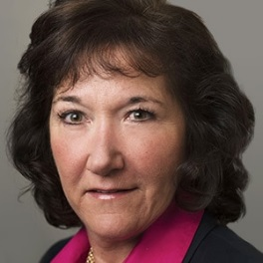
Board Bios (continued)
Elizabeth (Betsy) Rafael
Betsy Rafael has over 30 years of executive financial experience in the technology industry. Most recently, Ms. Rafael held the position of Vice President and Corporate Controller for Apple since 2007, and in January 2008 was appointed to the additional role of Principal Accounting Officer until her retirement in October 2012.
From April 2002 to September 2006, Ms. Rafael served as Vice President, Corporate Controller and Principal Accounting Officer of Cisco Systems, and held the position of Vice President, Corporate Finance for Cisco Systems from September 2006 to August 2007.
From December 2000 to April 2002, Ms. Rafael was the Executive Vice President, Chief Financial Officer, and Chief Administrative Officer of Aspect Communications, Inc., a provider of customer relationship portals. From April 2000 to November 2000, Ms. Rafael was Senior Vice-President and CFO of Escalate, Inc., an enterprise e-commerce application service provider.
From 1994 to 2000, Ms. Rafael held a number of senior positions at Silicon Graphics (SGI), culminating her career at Silicon Graphics as Senior Vice President and Chief Financial Officer. Prior to SGI, Ms. Rafael held senior management positions in finance with Sun Microsystems and Apple Computer. Ms. Rafael began her career with Arthur Young & Company.
Ms. Rafael has served on the board of directors of Echelon since November 2005, GoDaddy since March 2014, Shutterfly since June 2016, and previously served on the board of PalmSource. Ms. Rafael graduated magna cum laude from Santa Clara University with a B.S.C. degree in Accounting, and was appointed to the Santa Clara Board of Trustees in October 2012.

Slide 21
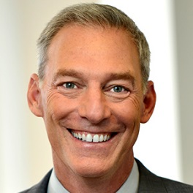
Board Bios (continued)
Stacy J. Smith
Stacy J. Smith is executive vice president leading manufacturing operations and sales for Intel Corporation. In this role, he oversees the company’s global technology and manufacturing group and its worldwide sales organization. Previously, he served as executive vice president, chief financial officer (CFO), and director of corporate strategy for Intel Corporation overseeing the company’s global finance organization including finance, accounting and reporting, tax, treasury, internal audit, investor relations, Intel Capital, information technology and the corporate strategy office.
Smith joined Intel in 1988 and has held positions in Finance, Sales and Marketing, and Information Technology. In March of 2006 he was appointed assistant chief financial officer. He has also held the position of chief information officer where he was responsible for Intel's Information Technology Group. He was the general manager of Intel Europe, Middle East and Africa (EMEA) where he was responsible for Intel product sales and marketing in the EMEA region. Smith became vice president of Sales and Marketing in 2002. Over the years, he has held Finance positions in various divisions, Components Manufacturing, Systems Manufacturing, and Sales and Marketing. He has been located with Intel in the US, Asia, Europe, and Latin America.
Smith holds an MBA degree in Finance from the University of Texas. In addition to Autodesk, Smith also serves on the board of Virgin America.

Slide 22
Executive Bios

Slide 23
Executive Bios
Andrew Anagnost
President and CEO
Board Director
Andrew Anagnost is the President and Chief Executive Officer of Autodesk.
Anagnost’s career spans more than 25 years of product, business, and marketing experience focused on driving strategy, transformation, and product development — and includes positions at Autodesk, Lockheed Aeronautical Systems Company, and EXA Corporation. He also completed a doctorate degree at Stanford University and worked at NASA Ames Research Center as an NRC post-doctoral fellow.
Anagnost began his career at Autodesk in 1997 and has held a wide range of roles in the areas of marketing, new business development, product management, and product development. Prior to becoming President and CEO in June 2017, he served as Chief Marketing Officer and SVP of the Business Strategy & Marketing organization. In this role, Andrew served as architect and leader of Autodesk’s business model transition—moving the company to become a software-as-a-service (SaaS) solutions provider. Previously, Anagnost held various executive positions across Autodesk. Early in his Autodesk career, he led the development of the company’s manufacturing products and grew Autodesk Inventor revenue to over $500 million.
Anagnost is a member of the Autodesk Board of Directors. He holds a Bachelor of Science Degree in Mechanical Engineering from the California State University, and holds both an MS in Engineering Science and a PhD in Aeronautical Engineering and Computer Science from Stanford University.

Slide 24
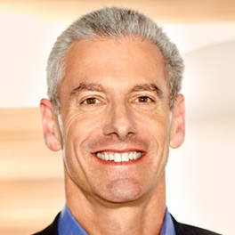
Executive Bios (continued)
Steve Blum
Senior Vice President, Worldwide Sales and Services
Steve Blum is Senior Vice President of Worldwide Sales and Services at Autodesk, Inc.
In this role, he is responsible for driving sales worldwide of Autodesk solutions into the AEC, Engineering, Natural Resources & Infrastructure, Manufacturing, and Media & Entertainment industries as well as to customers within Emerging Markets.
He also oversees the company’s consulting, premium support, named account, subscription, emerging market and channel programs around the world.
Prior to this position, Blum was Senior Vice President of Americas Sales at Autodesk. Under his leadership, revenue in the Americas more than doubled to over $700M. Blum is also credited with developing and implementing a partner channel framework and major account program that were expanded globally after their initial success in the Americas. In 2010, 2011 and 2012, he was recognized by CRN Magazine as a CRN Channel Chief.
Before joining Autodesk, Blum was Executive Vice President of Sales and Account Management for Parago, Inc., where he was responsible for sales of all products and support of all clients. He grew the national client base from 14 to 125 and expanded revenues from $19M to $26M.
Blum also held several sales positions of increasing responsibility at Mentor Graphics. His was Vice President of America’s sales, where he grew business from $200M to $250M during his tenure. He also served as Director of Consulting worldwide and Director of Americas Field Marketing.
Before joining Mentor Graphics, Blum held engineering and sales positions at Advanced Micro Devices and NCR Corporation where he earned a patent for developing a testing technique to evaluate undershoot and overshoot resistances in programmable logic devices.
Blum holds a bachelor's degree in electrical engineering from the University of Florida.

Slide 25
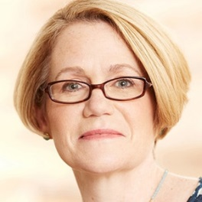
Executive Bios (continued)
Amy Bunszel
Senior Vice President, Design and Creation Products
As senior vice president of Design and Creation Products, Amy manages product strategy and execution for Autodesk’s 3D design and creation portfolio including the Autodesk Product Collections, AutoCAD family, Autodesk 3ds Max, Autodesk Inventor, Autodesk Revit, Autodesk Maya and more.
With more than 20 years of experience innovating software products across the architecture, engineering, and construction, manufacturing and media and entertainment industries, Amy inspires innovative strategy while driving large-scale agile software development around the globe. Amy combines her roots as a start-up co-founder with deep product management knowledge and large-scale product execution expertise to build high performing teams focused on delivering value to their customers.
Most recently, Amy Bunszel served as Autodesk vice president of Digital Engineering Products. In this role, she transformed the company’s best-selling AutoCAD product to a modern multi-platform offering that serves as the backbone of the company’s subscription business and led a global team in developing and delivering desktop, web and mobile apps that have been adopted by millions of design and engineering professionals worldwide. In her present role, she is building on her track record of modernizing beloved software across a Autodesk’s broad design and creation product portfolio.
Before joining Autodesk, Amy co-founded Linius Technologies in 1996. The company delivered wire harness design software to the manufacturing industry. Its technology was integrated with Autodesk’s Inventor 3D mechanical design software when Autodesk acquired the company in 2003.
Amy holds a B.S. in Electrical Engineering from Cornell University and an M.S. in Electrical Engineering from the University of Massachusetts, Amherst. Amy is a member of the President’s Council for Cornell Women, the Entrepreneurship Program at Cornell, and The Athena Alliance.

Slide 26
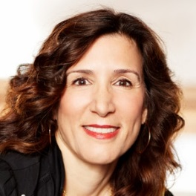
Executive Bios (continued)
Lisa Campbell
Senior Vice President, Business Strategy and Marketing
Lisa Campbell is senior vice president of business strategy and marketing at Autodesk, where she is responsible for business, industry and marketing strategy for the company. She is also responsible for driving brand affinity and loyalty among the current and next generation of Autodesk customers. Lisa has 25 years of software industry leadership experience with extensive knowledge in business and industry strategy in manufacturing, construction and infrastructure, digital go-to-market strategy, building brands, and business development. At both Fortune 500 companies and startups, Lisa has successfully partnered with leadership teams to transform brands, launch new products, and business models in the marketplace.
Most recently, Lisa served as vice president of Design & Manufacturing, Business Strategy & Marketing, focused on the company’s business strategy and marketing for the manufacturing industry. During her tenure, Lisa has held a series of leadership roles at Autodesk, including heading industry strategy and go-to-market for all of Autodesk’s industries and customer segments, as well as leading the architecture, engineering and construction and media & entertainment industry strategy and marketing organizations. She also held other key leadership positions including managing Autodesk’s Global eCommerce business and Autodesk.com, managing the Geospatial Business and infrastructure business for the company.
Prior to joining Autodesk in 2003, Lisa served as the vice president of marketing and product management for Evolve (now Oracle) where she was responsible for all marketing functions for the Service Delivery products, including brand, market strategy, marketing communications, product marketing and product management. Additionally, she held executive-level marketing positions at Sterling Software Inc., and Digital Equipment Corporation. Lisa began her career as an IT professional and product marketing manager at Digital Equipment Corporation, which was acquired by HP. Lisa holds a B.A. in mathematics and computer science from Boston College and an M.B.A. from Babson College.

Slide 27
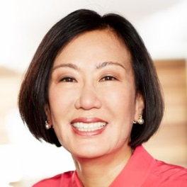
Executive Bios (continued)
Moonhie Chin
Senior Vice President, Digital Platform and Experience
Moonhie Chin is the Senior Vice President of Digital Platform and Experience at Autodesk. She is leading the charge to offer a superior digital experience for Autodesk customers wherever they engage with the company. She is also responsible for strategic initiatives and programs that seek to re-design and strengthen Autodesk’s business operations.
Her team’s charter is to deliver digital engagement capabilities that enable self-service customer experiences, automated interactions, and tools to help others to engage with customers most effectively. Chin is passionate about improving the end to end experience for customers and improving productivity for both Autodesk and our partners through anytime, anywhere service, support and information. Over the last four years, she invested significantly in online self-service and greatly expanded Autodesk’s learning, support and community offerings and extended their reach to other languages, reaching more than 10 million monthly active users. Her team also recently pioneered the Autodesk Virtual Agent, or AVA, in partnership with IBM Watson with the strategic intent of reducing customer effort and automating transactions or turning them into self-service interactions wherever possible.
Chin has held several executive roles during her tenure with Autodesk, including senior vice president of Global Customer Support and Operations, senior vice president of Strategic Planning and Operations, Vice President of Business Operations for Location Services and Vice President of Business Administration, as well as other leadership positions in software development, project management, subscription services, and other areas.
Before joining Autodesk in 1989, Chin spent eight years at General Electric. She earned a Bachelor of Science in Industrial Engineering from Columbia University and a Master of Science in Manufacturing Management from Rensselaer Polytechnic Institute.

Slide 28
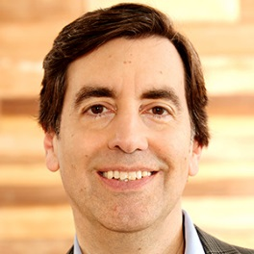
Executive Bios (continued)
Pascal W. Di Fronzo
Senior Vice President, Corporate Affairs, Chief Legal Officer & Secretary
Pascal Di Fronzo manages the company’s legal department, which is responsible for legal, corporate development, and public policy activities of Autodesk. He joined Autodesk in 1998 and has held various positions involving business and legal matters during his tenure at the company.
Prior to joining Autodesk, Di Fronzo advised high technology and emerging growth companies on business and intellectual property transactions and litigation while in private practice with the Palo Alto, California, law firm of Wilson, Sonsini, Goodrich & Rosati, as well with the Irvine, California, office of Washington, DC-based Ross, Dixon & Masback.
Di Fronzo serves on the board of directors of the Business Software Alliance (BSA) and has published and lectured on a variety of corporate and intellectual property law topics. He is a member of the California State Bar and received a Juris Doctor degree from the University of California, Hastings College of the Law and a Bachelor of Arts degree in Political Science from UCLA.
.

Slide 29
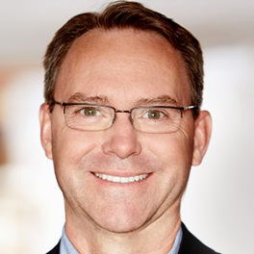
Executive Bios (continued)
R. Scott Herren
Senior Vice President and Chief Financial Officer
R. Scott Herren is senior vice president and chief financial officer of Autodesk, Inc. He is responsible for Autodesk’s global finance, information technology and procurement organizations. Prior to joining Autodesk in November 2014, Herren was senior vice president of finance at Citrix Systems where he led the company’s finance, accounting, tax, treasury, investor relations, real estate and facilities teams.
During his 14 years at Citrix, Herren held a variety of leadership roles including vice president and managing director for EMEA and vice president and general manager of the company’s virtualization systems group. Before joining Citrix in 2000, Herren spent 16 years in senior strategy and financial positions at FedEx and IBM. Herren serves on the board of directors of Proofpoint, Inc., and also serves as a member of Proofpoint’s audit committee.
Herren holds a Bachelor of Science degree in Industrial Engineering from Georgia Institute of Technology and a Master of Business Administration degree in Finance from Columbia University.

Slide 30
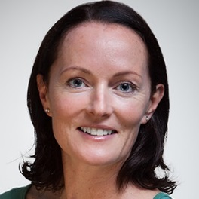
Executive Bios (continued)
Carmel Galvin
Chief Human Resources Officer
Carmel Galvin is chief human resources officer of Autodesk, Inc. and is responsible for leading the company’s efforts to attract, develop and retain the best talent. In addition, Galvin oversees Corporate Real Estate, Travel, Safety and Security (CREFTS).
Prior to joining Autodesk in 2018, Galvin was the chief human resources officer of Glassdoor where she led all people functions of the company, including human resources planning, learning & development, talent acquisition, employee relations and engagement, and more.
Galvin brings 25 years of human resources experience at global companies including Deloitte, Advent Software and MSCI Barra Inc. where she developed a particular focus on leadership coaching, developing organizational culture and employee engagement programs.
A native of Ireland, Galvin received her bachelor’s degree in political science and business from Trinity College Dublin and master’s degree in Business Studies at the University College Dublin’s Smurfit School of Business.

Slide 31
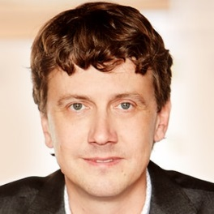
Executive Bios (continued)
Jeff Kowalski
Senior Vice President and Chief Technology Officer
Jeff is responsible for shaping 3D design and engineering software leader Autodesk's long-term technology vision, as well as driving innovation across the company. He and his team focus on research and development and strategy, turning emerging technologies into products and approaches that can help Autodesk’s customers.
Jeff joined Autodesk through the acquisition of a company he founded in 1993. He has held a number of roles at the company, and became CTO in 2006. Jeff earned a Bachelor's degree in electrical engineering and a Master's in computer science, at Cornell University.
Jeff’s insatiable curiosity sends him down a variety of Wikipedia and internet forum rabbit holes, from vacuum cleaners to vacuum tubes. When not CTO-ing, Jeff enjoys playing piano, hiking with his kids and exploring the myriad of cuisines available in his hometown of Berkeley, Calif.

Slide 32
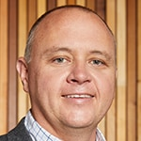
Executive Bios (continued)
Scott Reese
Senior Vice President, Manufacturing, Construction and Production Products
Scott Reese is senior vice president of Manufacturing, Construction and Production Products, which enable Autodesk customers to design and make things in new ways. Scott is focused on anticipating and supporting the needs of new industries which deliver long-term growth for Autodesk.
Scott manages all aspects of product development for Autodesk cloud products targeting the manufacturing, construction and media & entertainment industries. These products include Autodesk BIM 360, Autodesk Fusion 360, Autodesk Netfabb, Autodesk Powermill and Autodesk Shotgun, as well as the broader Autodesk Forge platform.
Previously, Scott served as the company’s vice president, Cloud Platforms and Operations.
During his Autodesk tenure, Scott also held the positions of senior director for Simulation; senior director of the Autodesk Digital Factory team; and product line manager for AutoCAD Electrical and AutoCAD Mechanical. He joined Autodesk in 2003 with the acquisition of VIA Development Corporation where he served as vice president.
Scott holds a Bachelor of Science degree in Computer Science as well as a Master’s Degree in Business Administration from Indiana Wesleyan University.

Slide 33
Board Calendar

Slide 34
Board Calendar 2018
Board/Committee | Confirmed Date | Confirmed Time/Place
Committee Meetings | Tuesday, March 20 | 3:00 – 6:00 pm PT ADSK Gallery, SF Office
Board of Directors Dinner (All Board Members) | Tuesday, March 20 | 6:00 pm PT ADSK Gallery, SF Office
Board of Directors Meeting | Wednesday, March 21 | 9:00 am – 3:00 pm PT ADSK Gallery, SF Office
Board of Directors Dinner (All Board Members) | Monday, June 11 | 6:00 pm PT ADSK Gallery, SF Office
Committee Meetings | Tuesday, June 12 | 8:00 – 9:45 am PT ADSK Gallery, SF Office
Board of Directors Meeting | Tuesday, June 12 | 10:00 am – 2:45 pm PT ADSK Gallery, SF Office
Annual Stockholder Meeting | Tuesday, June 12 | 3:00 pm PT ADSK Gallery, SF Office

Slide 35
Director Compensation

Slide 36
Director Compensation

